Slide 1





Target
Project Idea
Implementation
Who are we ?

Slide 2


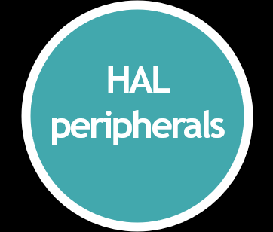


Slide 3
Project Name : Smart Home & Communication System
System Diagram :
LABTOP
Communication Channel : Simplex
DockLight application
Stm32f103c8t
Microcontroller
Based on Arm Cortex m3
Atmega32a
Microcontroller
AVR Kit
KeyPad
H.W1
H.W2
H.W3

Slide 4
Microcontroller Abstraction Layer Peripherals :
DockLight application
Stm32f103c8t
Microcontroller
Based on Arm Cortex m3
Atmega32a
Microcontroller
KeyPad
H.W1
RCC
H.W3
H.W2
UART
Tx, Rx
GPIO
ADC
Timer
UART
Rx

Slide 5
Entire System :
Stm32f103c8t
Microcontroller
Based on Arm Cortex m3
Atmega32a
Microcontroller
UI
RCC
UART
Tx, Rx
KeyPad
Mode
GPIO
ADC
Timer
UART
Rx
LCD
Relay
DC
LEDs
Auto
Manual

Slide 6
Hardware Abstraction Layer peripherals :
DockLight application
Stm32f103c8t
Microcontroller
Based on Arm Cortex m3
Atmega32a
Microcontroller
KeyPad
H.W1
H.W2
H.W3
Relay
DC Motor
LEDs
LCD
KeyPad

Slide 7

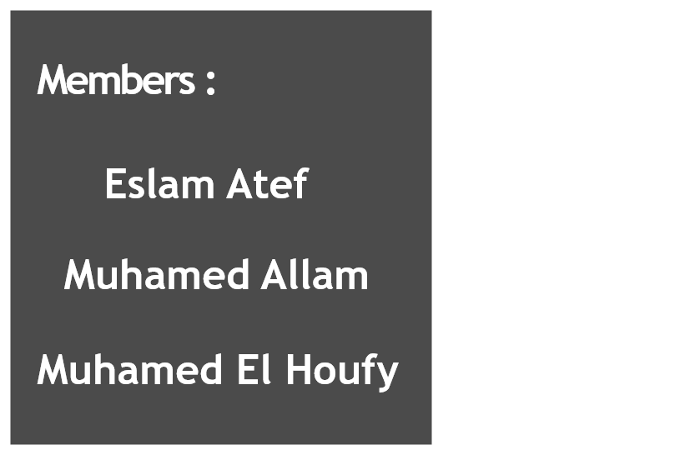

Who are we ?

Slide 8
إسلام عاطف ضاحى جابر
Members :
Eslam Atef
محمد رفعت محمود علام
Muhamed Allam
Muhamed El Houfy
محمد محمد عبد العزيز الحوفى

Slide 9

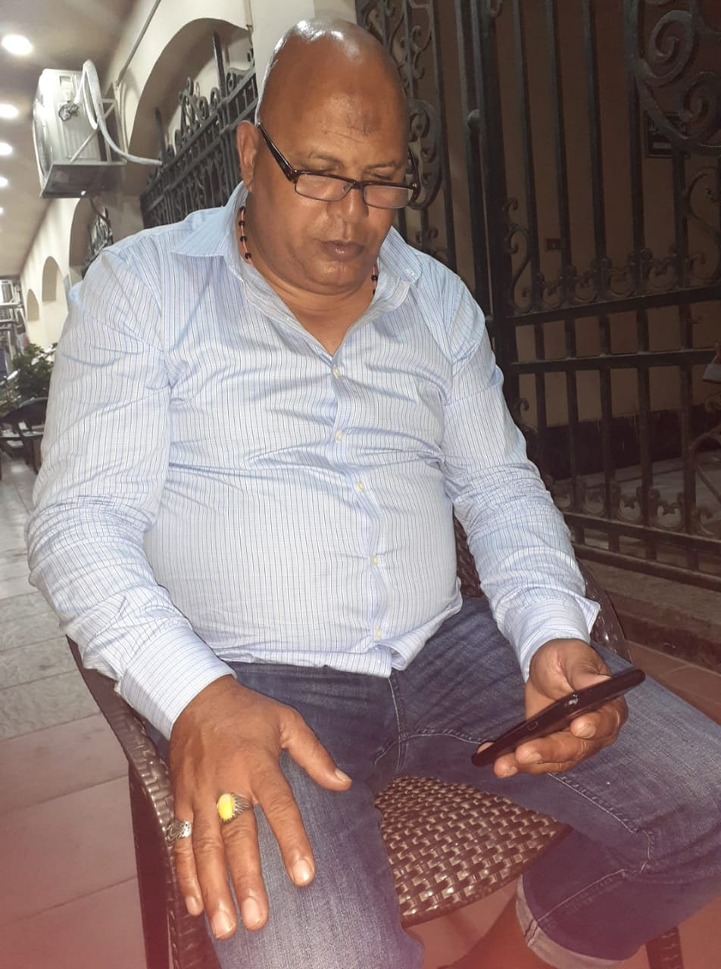
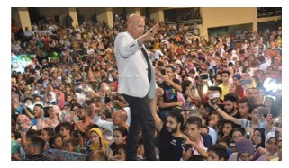
Team El Z3ama

Slide 10


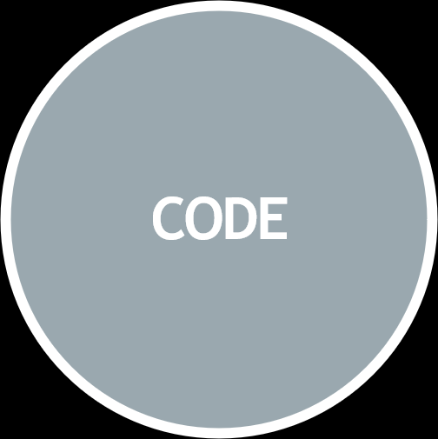
Implementation

Slide 11
Based on Machine States
switch(currentState)
CODE
Non RTOS Context
(super Loop)
AVR , ARM

Slide 12

Target
Full duplex medium
More appliances
RTOS Context

